Slide 1
Assessment of the insulation quality of a 60 kV inductive voltage transformer
Miniproject for High Voltage Engineering course
Group 4

Slide 2
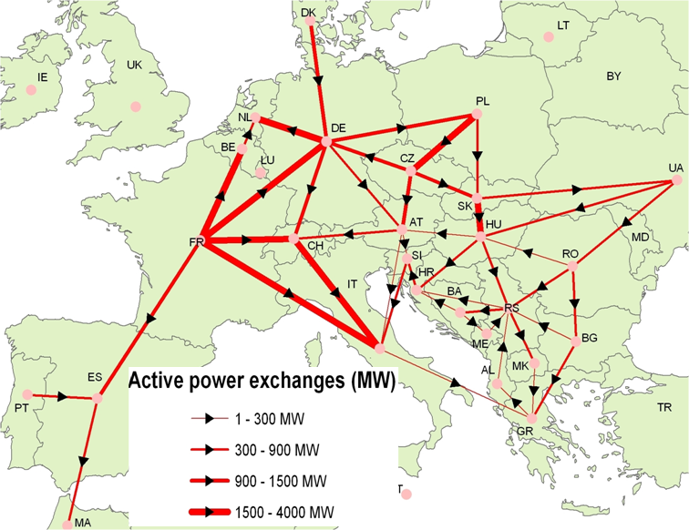
Power systems
Designed for long term use (20-30years);
Stresses beyond normal operation should accounted for and handled properly;
Non-restoring insulation should be properly designed and protected;
2 design directions:
Voltage stresses determination;
Response of insulation to them
(ec.europa.eu)

Slide 3
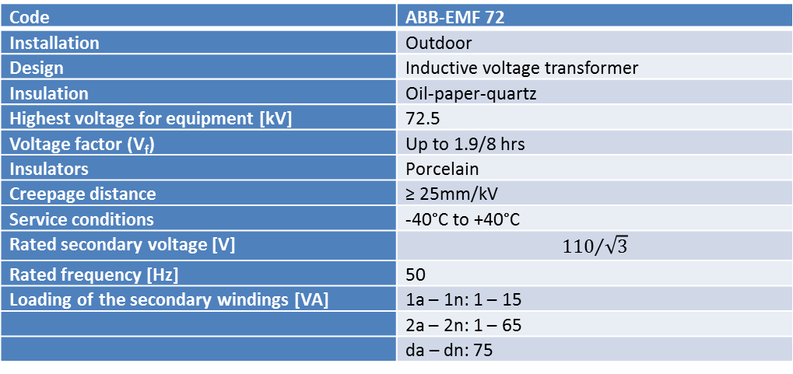
Transformer under test
Inductive voltage transformer designed for connection between phase and ground;
Low flux density, designed to withstand 190% of rated voltage for 8hours;
Code | ABB-EMF 72
Installation | Outdoor
Design | Inductive voltage transformer
Insulation | Oil-paper-quartz
Highest voltage for equipment [kV] | 72.5
Voltage factor (V_{f}) | Up to 1.9/8 hrs
Insulators | Porcelain
Creepage distance | ≥ 25mm/kV
Service conditions | -40°C to +40°C
Rated secondary voltage [V] | $${110}/{\sqrt{3}}$$
Rated frequency [Hz] | 50
Loading of the secondary windings [VA] | 1a – 1n: 1 – 15
 | 2a – 2n: 1 – 65
 | da – dn: 75
ABB EMF 72 (abb.com)

Slide 4
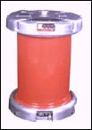
Test transformer
Specially designed for use in test setups;
5kVA nominal power;
2 primary 220V windings;
1 secondary High Voltage winding 100kV;
Supplied through a converter for voltage variation from a PLC interface;
TEO 100/10

Slide 5
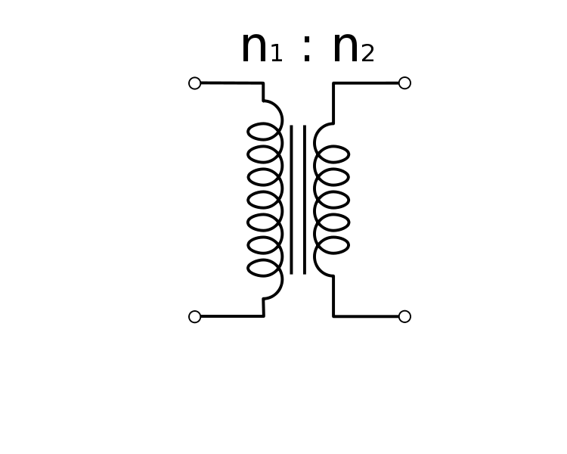
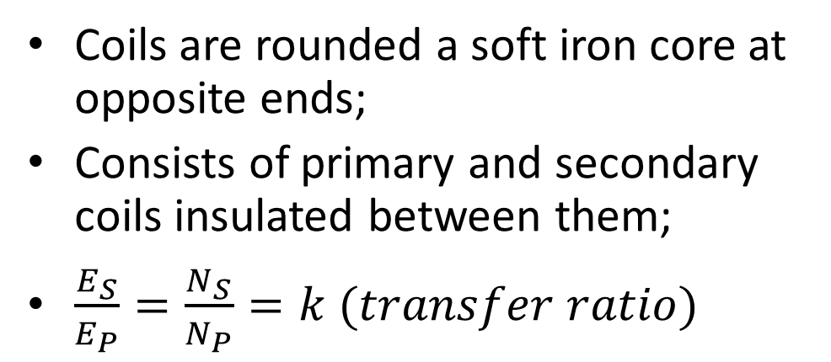
Transfer ratio
Transformer works based on electro-magnetic induction;
Consists of primary and secondary coils insulated between them;
Test setup
Coils are rounded a soft iron core at opposite ends;
Consists of primary and secondary coils insulated between them;
$\frac{E_{S}}{E_{P}}=\frac{N_{S}}{N_{P}}=k (transfer ratio)$
(elementaryelectronics.com)

Slide 6
Transfer ratio
Measurement from 10KV in increments of 10kV;
For accuracy measured for 2 secondary windings;
Voltage measured using capacitive voltage divider on HV side and Fluke multimeter on LV side;
Differences between theory and practice.
Measurements and theoretical value
 | V_{high} [kV] | V_{low} [V] | Ratio
da-dn | 10.18 | 19.62 | 0.0019
da-dn | 19.7 | 37.6 | 0.0019
da-dn | 29.77 | 55.7 | 0.0019
da-dn | 39.9 | 74.8 | 0.0019
1a-1n | 10.33 | 19.45 | 0.0019
1a-1n | 19.83 | 36.87 | 0.0019
1a-1n | 30.2 | 55.28 | 0.0018
1a-1n | 40 | 73.2 | 0.0018
theory | 34.64 | 63.5 | 0.0018

Slide 7
Power frequency testing
The test is performed to show that the insulation of the transformer can withstand the power frequency overvoltage that can occur.
Test voltage > expected working voltage
The tests consist of one-minute power frequency tests under 50/60 Hz
Indoor installation → dry condition tests

Slide 8
Power frequency testing
Rated power of the transformer: 72.5 kV
IEC document 28 CO 58,1992 → standard power frequency short-duration withstand voltage: 145 kV
Laboratory equipment limitations: 100 kV

Slide 9
Power frequency testing
Because of the nonlinear characteristic of the inductive voltage transformer at high voltages → high currents (overcurrent protection was triggered)
Current limiting resistors were inserted in the setup (R₁=50.1 [kΩ], R₂ = 282 [kΩ], R₃=1 [MΩ] &
I_{ON} = 22.7 [A] )

Slide 10
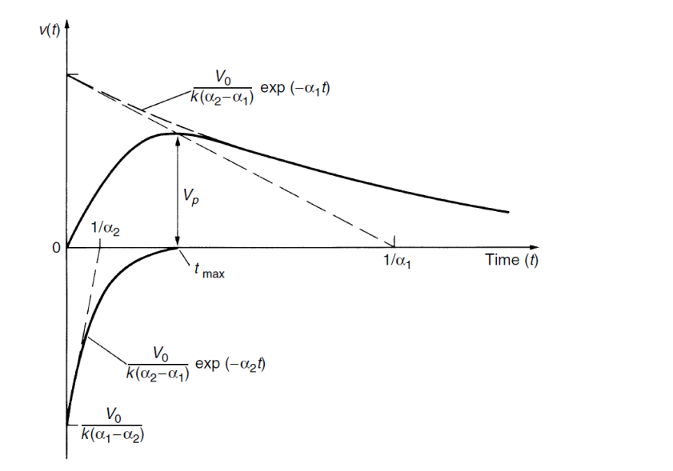


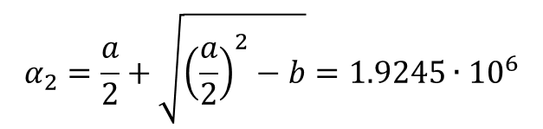
Lightning Impulse Test
$a=\left(\frac{1}{R_{1}∙C_{1}}+\frac{1}{R_{1}∙C_{2}}+\frac{1}{R_{2}∙C_{1}}\right)=$1.9255 $∙$10⁶
$$α_{1}=\frac{a}{2}−\sqrt{{\left(\frac{a}{2}\right)}^{2}−b}=939.7945$$
$b=\frac{1}{R_{1}∙R_{2}∙C_{1}∙C_{2}}$=1.8086 $∙$10⁹
$$α_{2}=\frac{a}{2}+\sqrt{{\left(\frac{a}{2}\right)}^{2}−b}=1.9245∙{10}^{6}$$
$k=R_{1}∙C_{2}$=5.82 $∙$10⁻⁷
$$V\left(t\right)=\frac{V_{0}}{k}∙\frac{1}{{(α}_{2}−α_{1})}∙\left[\exp\left(−α_{1}∙t\right)−\exp\left(−α_{2}∙t\right)\right]=93021.17∙[e^{−939.7945∙t}−e^{−1.9245∙{10}^{6}∙t}]$$

Slide 11
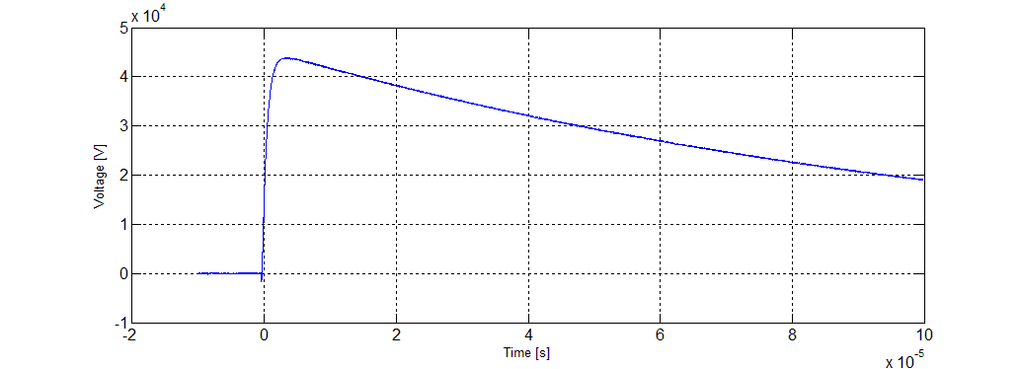

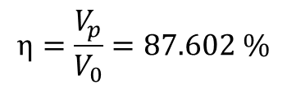
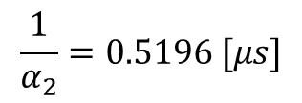
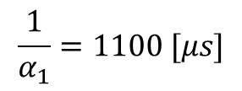



$$η=\frac{V_{p}}{V_{0}}=87.602 \%$$
$$\frac{1}{α_{1}}=1100 [μs]$$
$$t_{max}=3.9637 [μs]$$
$$t_{f(30\%→90\%)}=1.2899 [μs]$$
$$\frac{1}{α_{2}}=0.5196 [μs]$$
$$t_{h(V_{p}→V_{p}/2)}=79.7273 [μs]$$
$$V_{max}=43.801 [kV]$$
T=19 [°C], p=767 [mmHg] measurements correlated STC
Using the presented setup for the 50 kV level the test is not in the accepted tolerance for a standard lightning impulse test.
Therefore it cannot be concluded about the voltage impulse stress capabilities of the device under test.

Slide 12
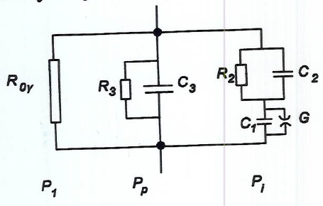

Dielectric loss angle measurement
Equivalent circuit of a lossy dielectric
Model of a real capacitor
Ideal capacitor
P1 – conduction losses
Pp – polarization losses
Pi – ionization losses
Total losses:
Pdiel = P1+Pp+Pi

Slide 13
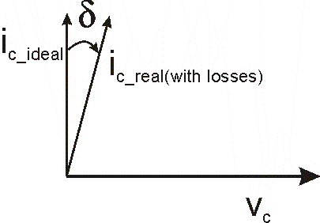
Dielectric loss angle measurement
The dielectric loss factor (tg δ) of a capacitor is defined as the ratio of active current to the reactive current flowing through the capacitor:
$$\tan{φ}=\frac{I_{w}}{I_{wl}}=\frac{P_{diel}}{Q}$$

Slide 14
Dielectric loss angle measurement
Schering bridge:
High precision measurement of Rx and Cx
Working principle:
After the bridge is equalized (V_ab=0), Rx and Cx can be calculated based on the values of the variable(known) resistor and capacitor R3 and C4

Slide 15



Dielectric loss angle measurement
After balancing the bridge with R₄ and C₄,
$$Z_{x}∗Z_{4}=Z_{N}∗Z_{3}$$
$\left|Z_{x}\right|∗\left|Z_{4}\right|=\left|Z_{N}\right|∗\left|Z_{3}\right|$
and $φ_{x}∗φ_{4}=φ_{N}∗φ_{3}$
$$φ_{N}=90˚$$
$$φ_{3}=0˚$$
$$φ_{4}=90˚−φ_{x}=δ$$
$$\tan{δ}=ω∗R_{4}∗C_{4}$$

Slide 16
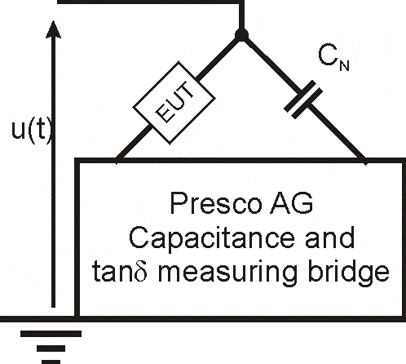
Dielectric loss angle measurement
Test setup:
EUT:
60kV transformer
Capacitor

Slide 17
Dielectric loss angle measurement
Transformer:
Measurement No. | U [kV] | Cx [pF] | Ix [uA] | tgδ [-] | δ [°]
1 | 10.38 | 68.6 | 222 | -0,0617 | -3.5307
2 | 14,86 | 74.79 | 350 | -0,1441 | -8.1999
3 | 19.54 | 77.78 | 478.3 | -0,1878 | -10.6363
4 | 24.6 | 78.84 | 609.8 | -0,2155 | -12.1613
5 | 29,78 | 78.17 | 732.16 | -0,2332 | -13.1268
6 | 34.41 | 76.06 | 822.19 | -0,2442 | -13.7231
7 | 39.47 | 70.9 | 881 | -0,231 | -13.0072
Capacitor:
Measurement No. | U [kV] | Cx [pF] | Ix [uA] | tgδ [-] | δ [°]
1 | 5.08 | 20.041 | 32 | 0,0775 | 4.4316
2 | 9,97 | 20.095 | 63.7 | 0,0807 | 4.6138
3 | 14,83 | 20.121 | 93.8 | 0,0829 | 4.7390
4 | 19,76 | 20.132 | 124.8 | 0,0845 | 4.8300
Based on the experiment, the capacitor had a smaller loss angle
than the transformer

Slide 18
Partial discharge measurements
A partial-discharge is defined as a “ localized electrical discharge that only partially bridges the insulation between conductors and which may or may not occur adjacent to a conductor”
We can further subdivide partial discharges into the following two categories:
Internal discharges
External discharges

Slide 19
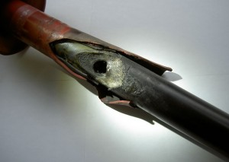
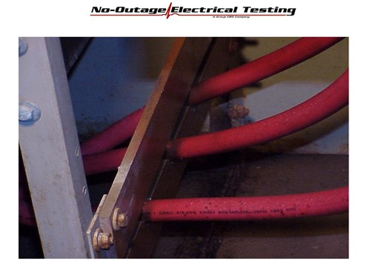
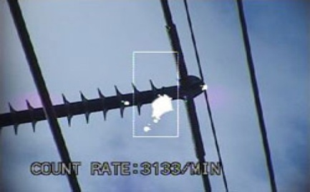
Partial discharge measurements
Internal discharges are partial discharges in cavities in solid or liquid dielectrics.
The external discharges can further be divided into surface discharges and corona.
Surface discharges are partial discharges in boundaries between different dielectrics and will cause erosion on the insulation.
“Corona are external discharges that occur in gaseous media around conductors which are remote from solid or liquid insulation”

Slide 20
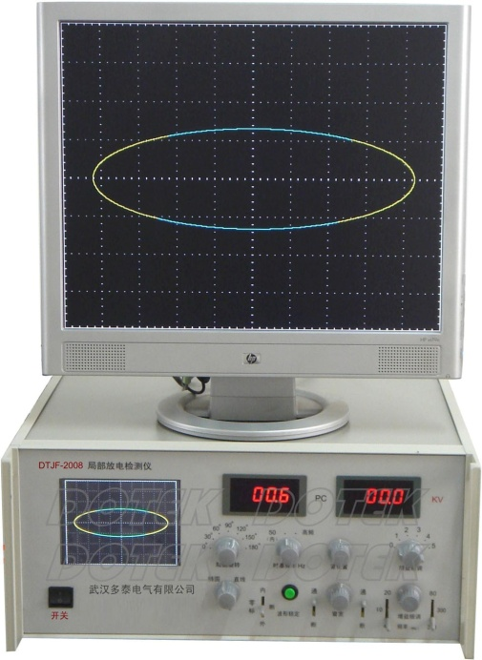
Partial discharge measurements
A partial-discharge measurement will not only show if there are partial discharges taking place but also if it is external or internal discharges. A distinction can be made based on the phase location of the discharge.
External discharges will occur at 90 and 270 degrees
Internal discharges typically occur at zero crossing (0 and 180 degrees).

Slide 21
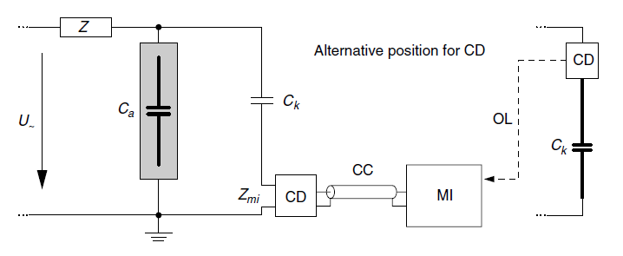
Test setup
The figure shows the test object C_{a} in parallel with the coupling capacitor C_{k}. The coupling device, CD, is connected in series with the coupling capacitor.
The CD is connected to the measuring device through optical cables.
The voltage U~ is the AC terminal voltage applied by an external power source which is user-controlled.

Slide 22
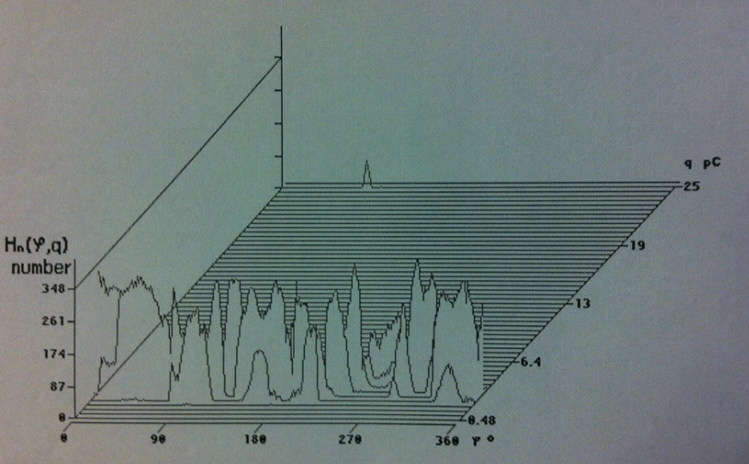
Experiments
In order to assess the level of PDs within/on top of the test object the “correct” voltage had to be applied.
A certain voltage level had to be be applied in order to be able to record any PDs within a reasonable timeframe.
If the voltage level became too high actual flashovers happened and the test will had to be repeated with lower voltage levels.

Slide 23
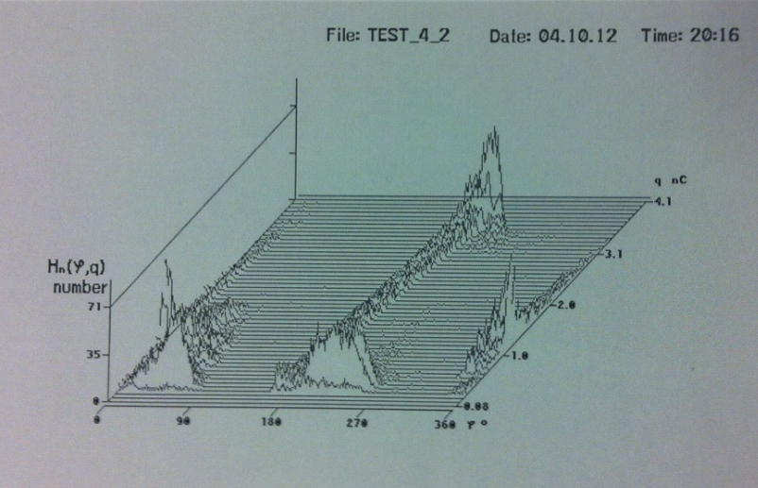
Experiment 1 (Homemade capacitor)
The three axes show the following:
H_{n}: The number of PDs
q: The energy of the PD
y: The voltage phase angle at the time of the PD
PDs occur at 0 degrees as well as at 180 degrees which shows that we are looking at internal partial discharges.

Slide 24
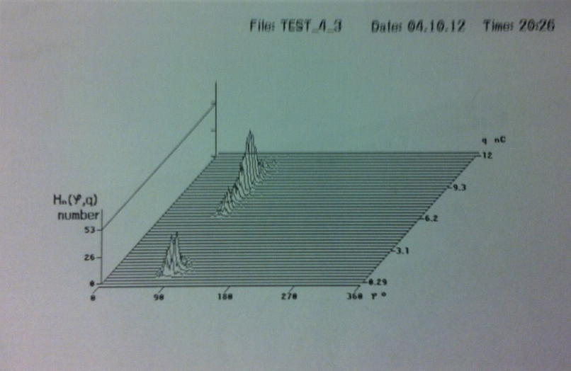
Experiment 2 (Rod-to-rod plane)
The three axes show the following:
H_{n}: The number of PDs
q: The energy of the PD
y: The voltage phase angle at the time of the PD
The partial discharges occur at 90 degrees only which means that the phenomena observed is corona.

Slide 25
6 – Dielectric spectroscopy test
Non-destructive diagnostic techniques based on changes of dielectric properties of the insulation.
Purpose
Assess the condition of oil/cellulose insulated equipment to increase the life time of expensive HV components, such as power transformers.
Can be divided in:
Dynamic properties in the Time domain
Dynamic properties in the Frequency domain

Slide 26

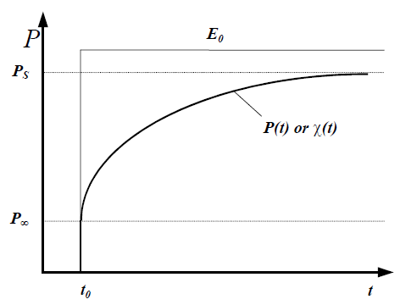
Dynamic properties in the Time domain
Theory
Dielectric Material
Electric Field (E)
Polarization (P)
Polarization of a dielectric material subjected to an electrical step field of magnitude Eo

Slide 27
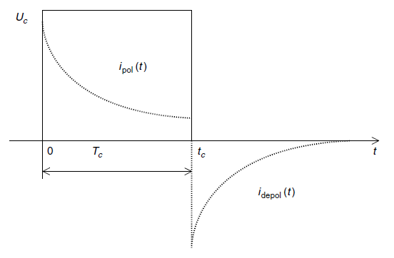
Dynamic properties in the Time domain
The polarization P(t) is not an observable magnitude by itself, but it produces a main part of the displacement current in a test object
Polarization Current
Depolarization Current

Slide 28
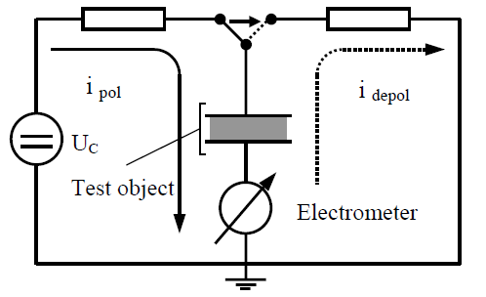
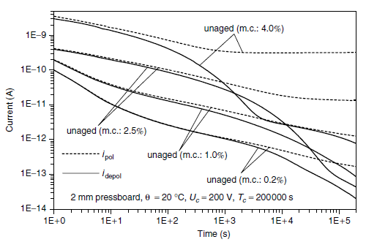
Dynamic properties in the Time domain
Sample Results
Principle of the test
Sample Results in Log scale

Slide 29
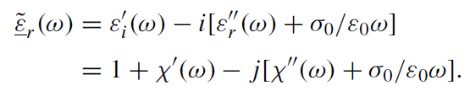
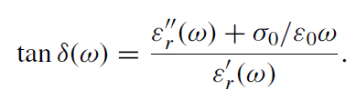
Dynamic properties in the Frequency domain
Several measurements at different frequencies are performed
the complex relative permittivity ε(ω) at the frequency of the applied field can be found
the dissipation factor tan δ
The real part defines the capacitance of a test object, while the imaginary part represents the losses

Slide 30
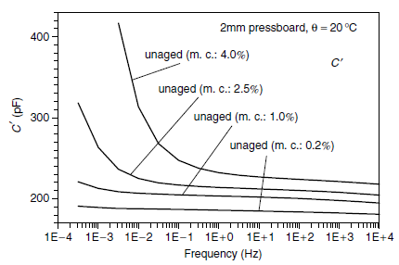
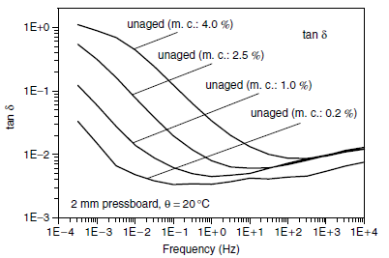
Dynamic properties in the Frequency domain
Sample Results

Slide 31
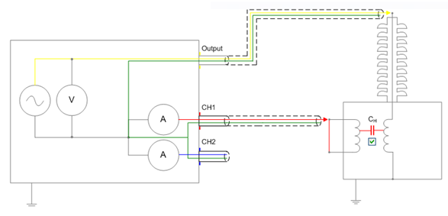
6 – Dielectric spectroscopy test
Test Setup
Voltage
Transformer
secondary short-circuited

Slide 32
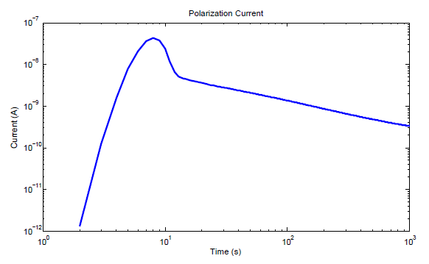
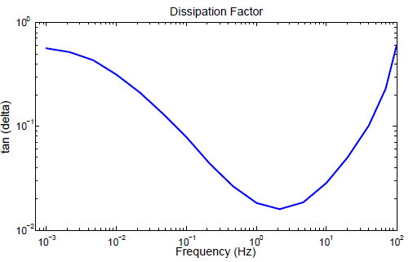
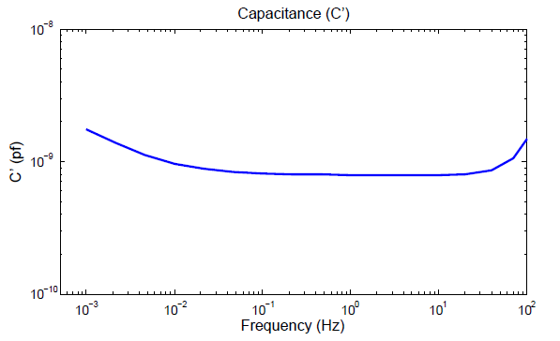
Polarization Current
Capacitance and Dissipation Factor

Slide 33
Conclusion
Good ☺
It works!

